Slide 1



Christopher Reynolds
Supervisor: Prof. Michael J.E. Sternberg
Bioinformatics Department
Division of Molecular Biosciences
Imperial College London

Slide 2
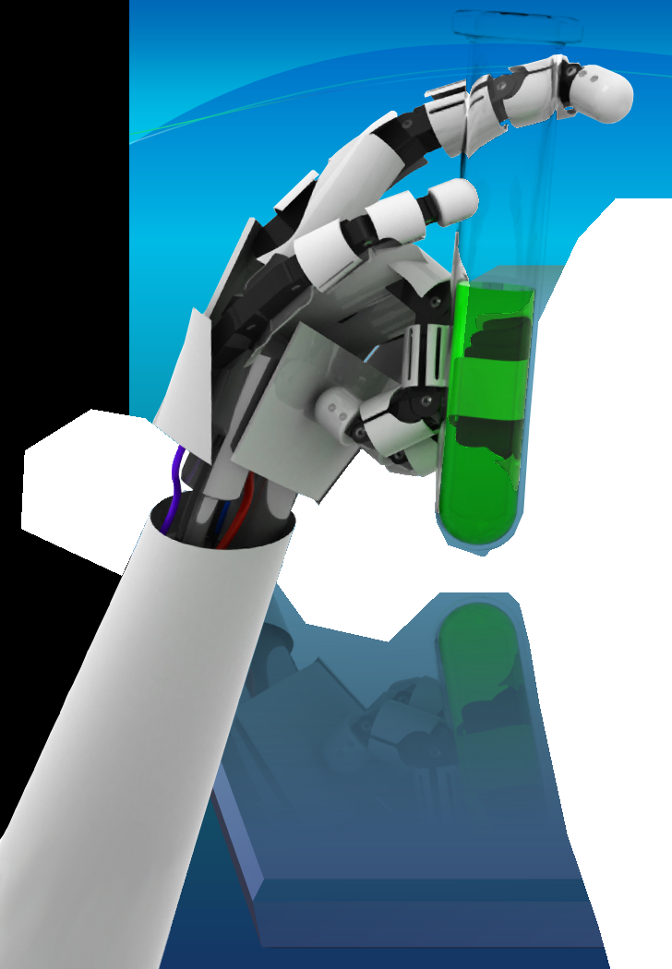
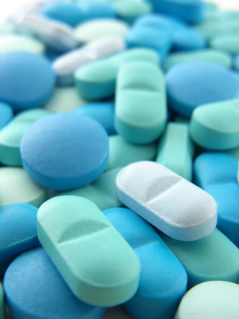

The Silicon Chemist
Integrating logic-based machine learning, virtual screening, and virtual chemistry to design new drugs automatically.

Slide 3

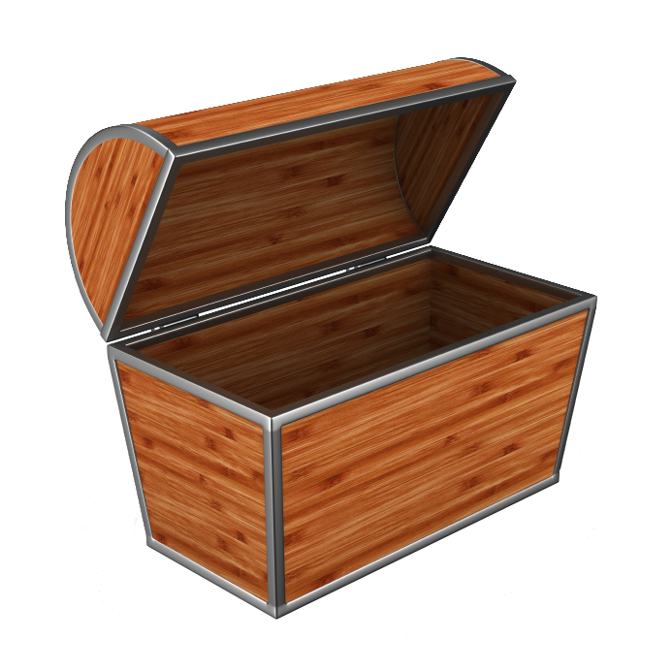
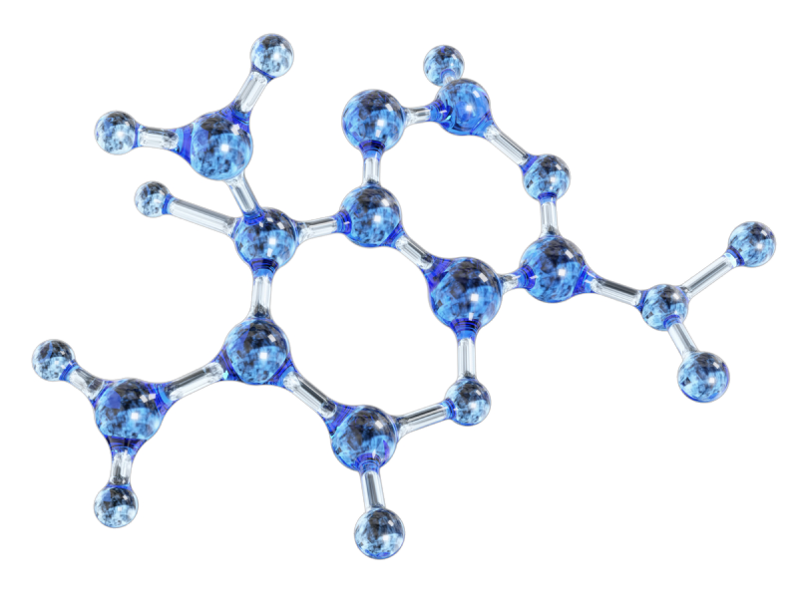

Slide 4

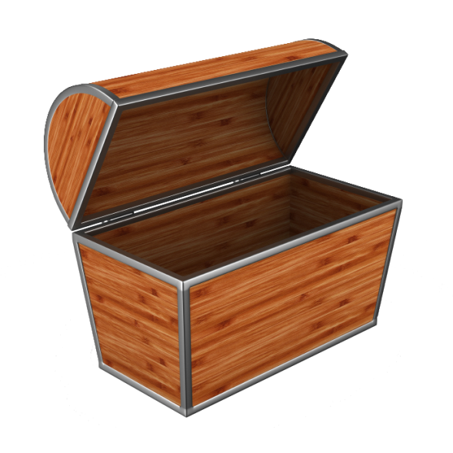
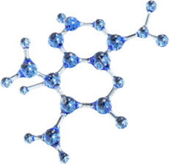

Slide 5
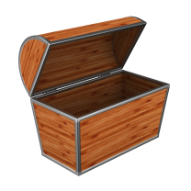

Slide 6


Slide 7
Searching for drugs
The number of synthetically feasible, drug-like molecules is estimated to be around 10⁶⁰.
New drug leads are always needed, and the rate of new drugs reaching the market is decreasing.
High throughput methods too slow and inefficient.
Hit rates around 0.3%.
Virtual screening methods faster and cheaper.
Hit rates of up to 30%.
Databases of drug-like molecules are still just a fraction of chemical space.

Slide 8
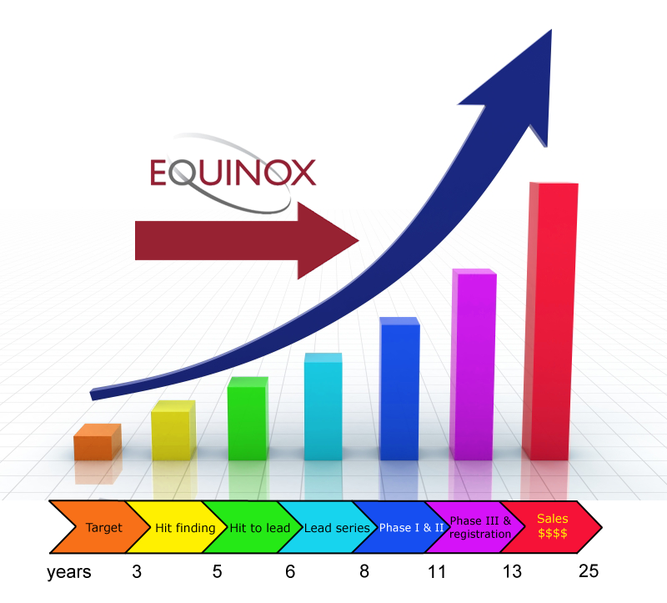
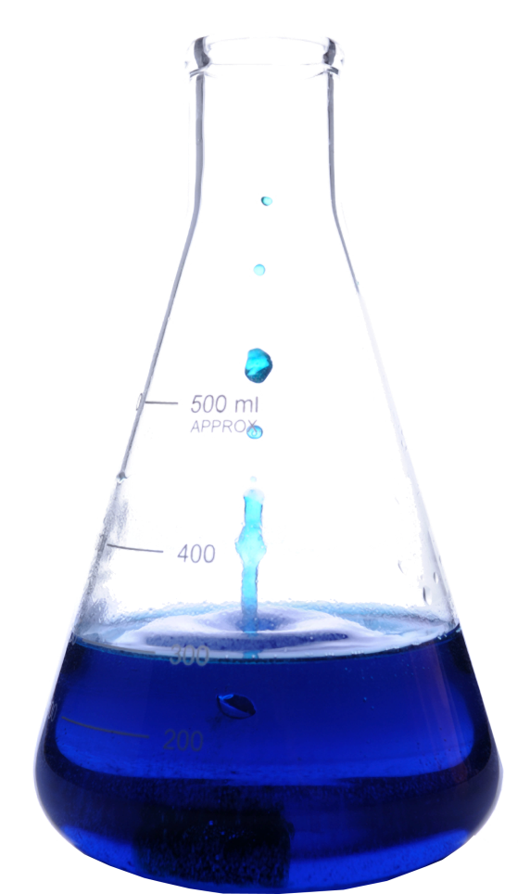
Phases of drug design

Slide 9
Objectives of this project
Produce a tool that can contribute to future drug design.
Test the success and viability of this approach against other methods.
Identify at least one small molecule with improved activity over existing drugs with the same target.
Submit some of the molecules produced for pharmaceutical testing.
Disseminate results.

Slide 10
INDDEx™
Investigational Novel Drug Discovery by Example.
A proprietary technology developed by Equinox Pharma that uses Inductive Logic Programming (ILP) for drug discovery.
This approach generates human-comprehensible weighted rules which describe what makes the molecules active.
In a blind test, INDDEx™ had a hit rate of 30%, predicting around 30 active molecules, each capable of being the start of a new drug series.

Slide 11
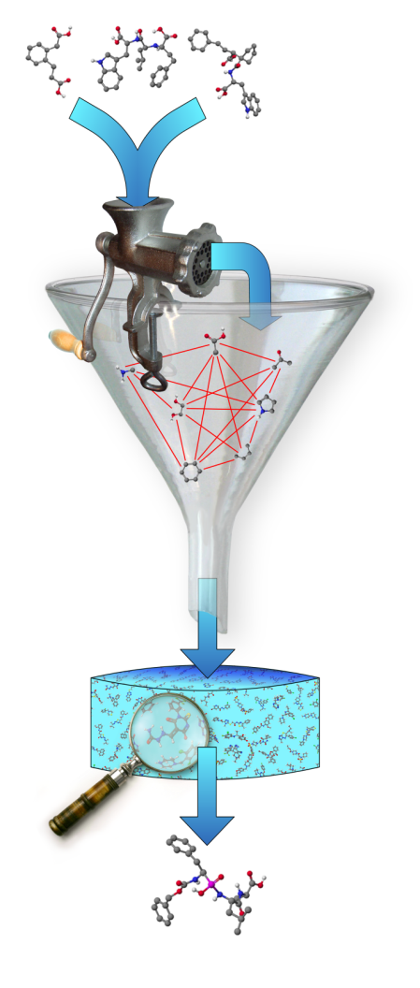
Observed activity
Fragmentation of molecules into chemically relevant substructure
Inductive Logic Programming generates QSAR rules
Screens model against molecular database
Novel hits

Slide 12
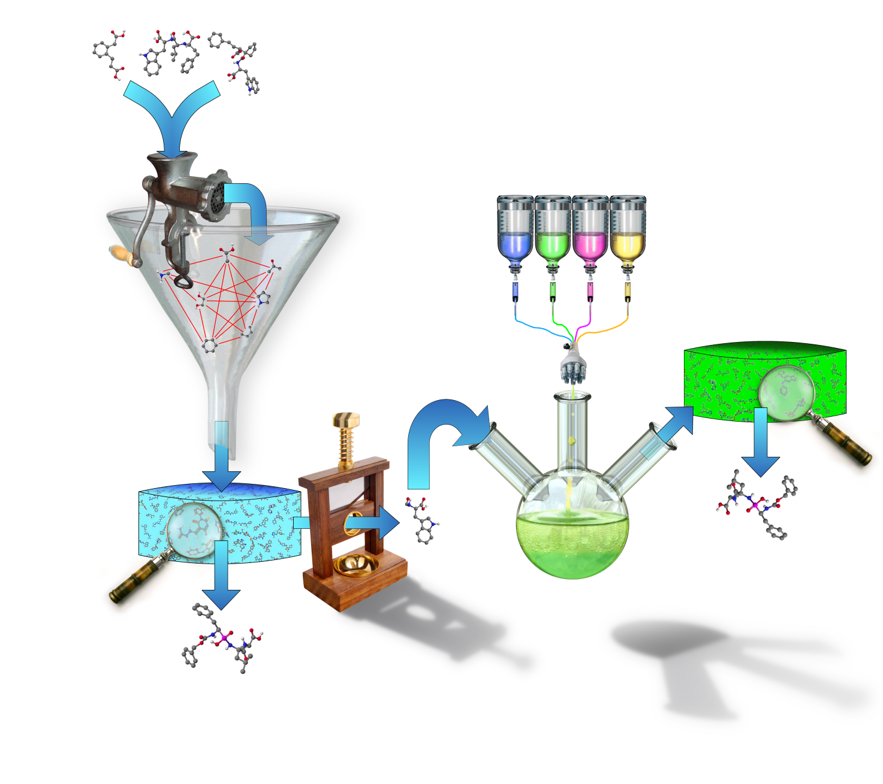
Database of virtual reactions
Modified molecules
Screen
Novel hits on synthesisable molecules
Modify using all viable reactions
Molecules with high ligand efficiency taken out

Slide 14
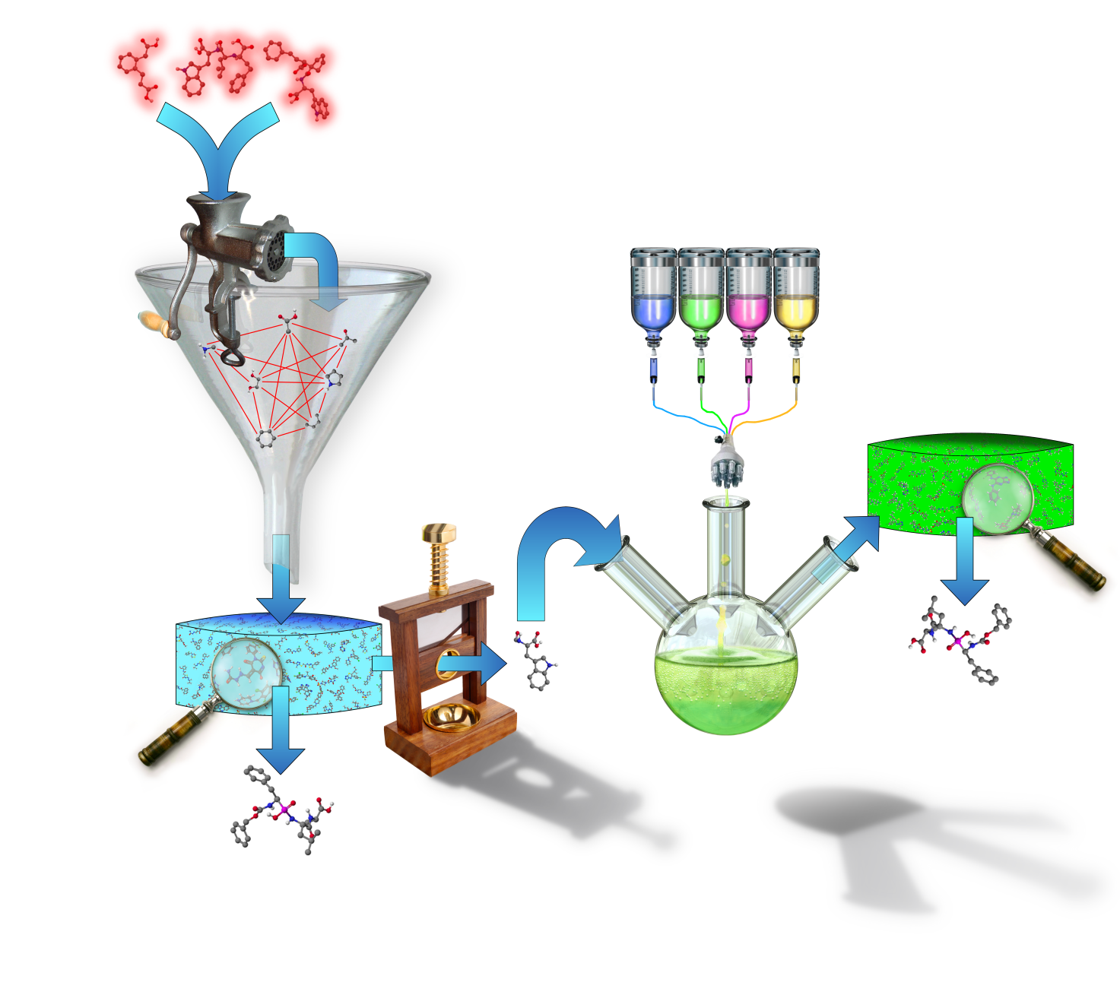

Slide 16
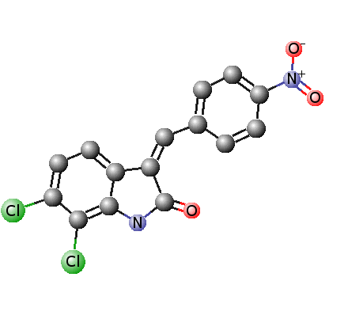
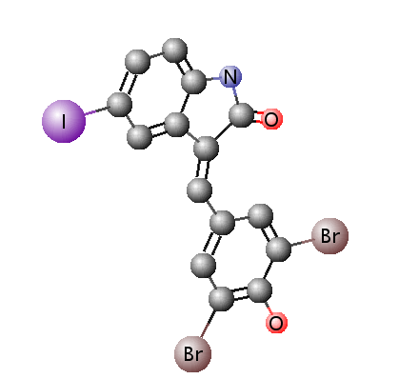
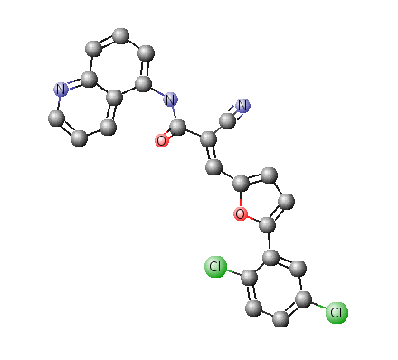
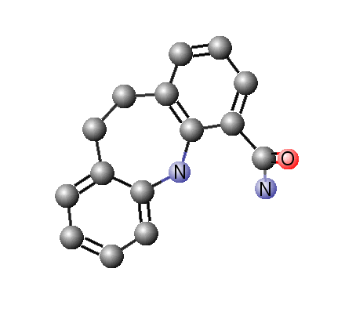
Dataset

Slide 18
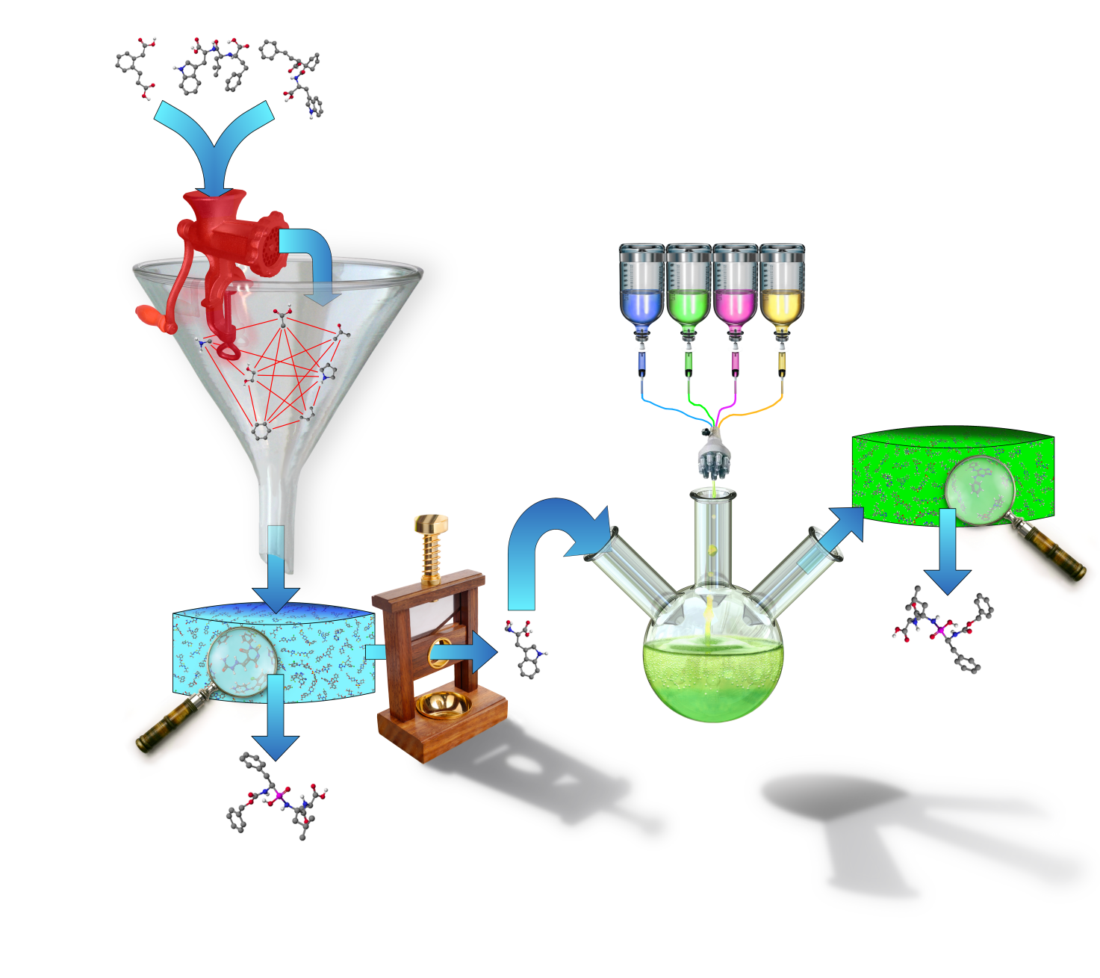

Slide 20
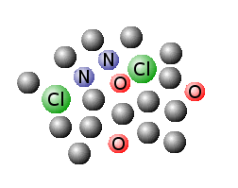
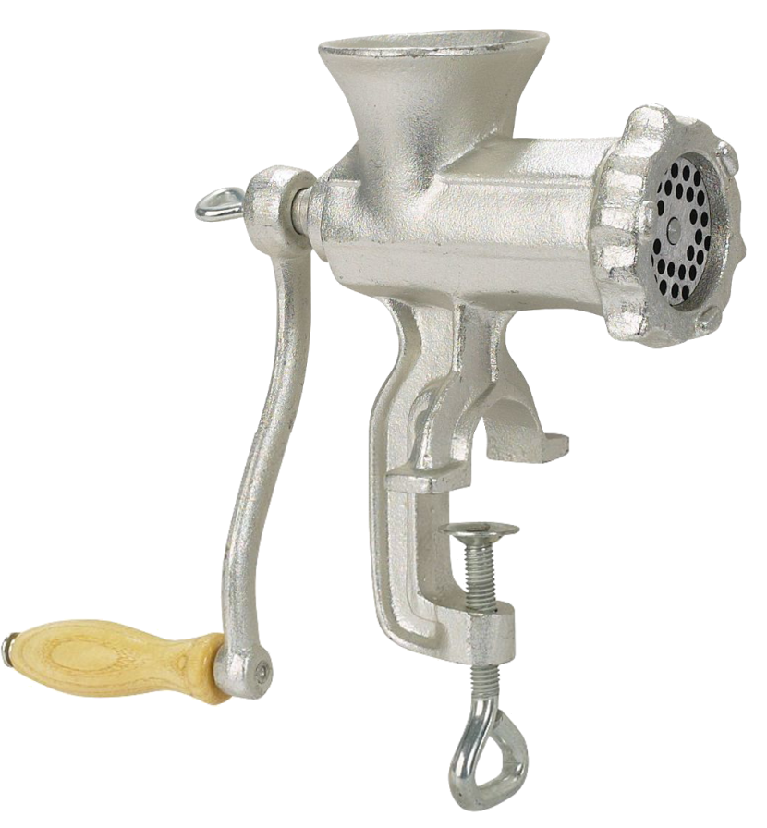
Fragmentation
Molecules broken into chemically relevant fragments.
Simplest fragmentation is to break the molecule into its component atoms.
More complex fragmentations break the molecule into fragments relating to hydrophobicity and charge.

Slide 22
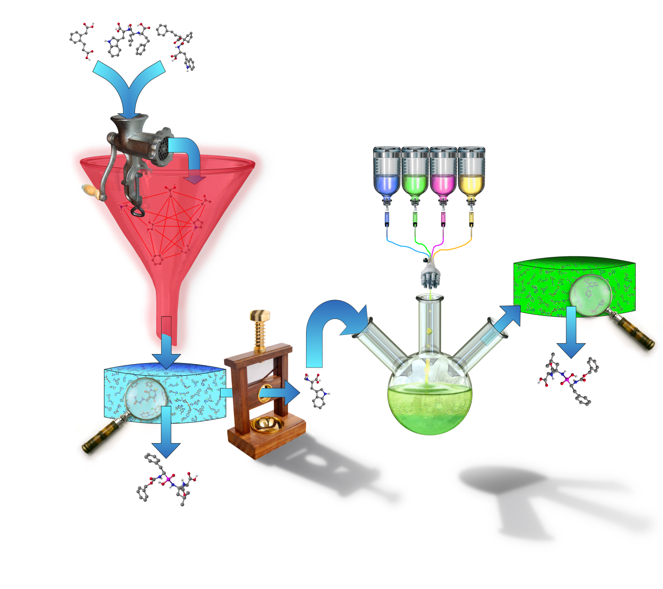

Slide 24
Deriving logical rules
Create a series of hypotheses linking the distances of different structure fragments.
For each hypothesis, find how good an indicator of activity it is (compression).
Hypotheses above a certain compression can be classed as rules.

Slide 25
Example ILP rules
active(A):- positive(A, B), Nsp2(A, C), distance(A, B, C, 5.2, 0.5).
Molecule is active if there is a positive charge centre and an sp₂ orbital nitrogen atom 5.2 ± 0.5 Å apart.
active(A):- phenyl(A, B), phenyl(A, C), distance(A, B, C, 0.0, 0.5).
Molecule is active if a phenyl ring is present.

Slide 26
Quantifying the rules
Kernel for machine learning
Derived rules | Mol 1 | Mol 2 | Mol 3 | Mol 4
Activity
Rule 1 | 0 | 1 | 1 | 0
Rule 2 | 1 | 0 | 1 | 0
Rule 3 | 1 | 1 | 1 | 0
Rule 4 | 0 | 1 | 1 | 1
Derived rules | Compression
Rule 1 | 0
Rule 2 | 0
Rule 3 | 0.7
Rule 4 | -0.7
+
+
−
−
Support
Vector
Machine
Inductive
Logic

Slide 28
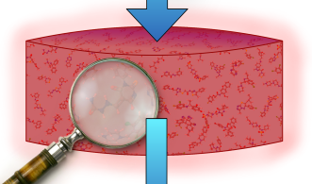

Slide 30
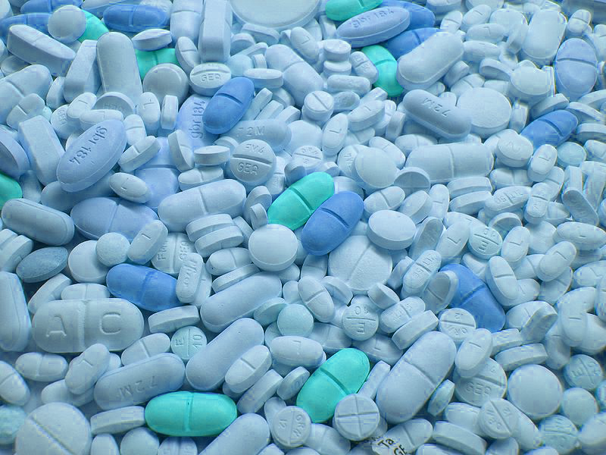
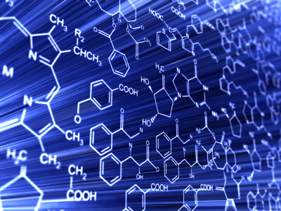
Screening
Apply model to a database of molecules. (ZINC)
Contains 11,274,443 molecules available to buy “off-the-shelf”.
INDDEx™ pre-calculates descriptors to save time.

Slide 32
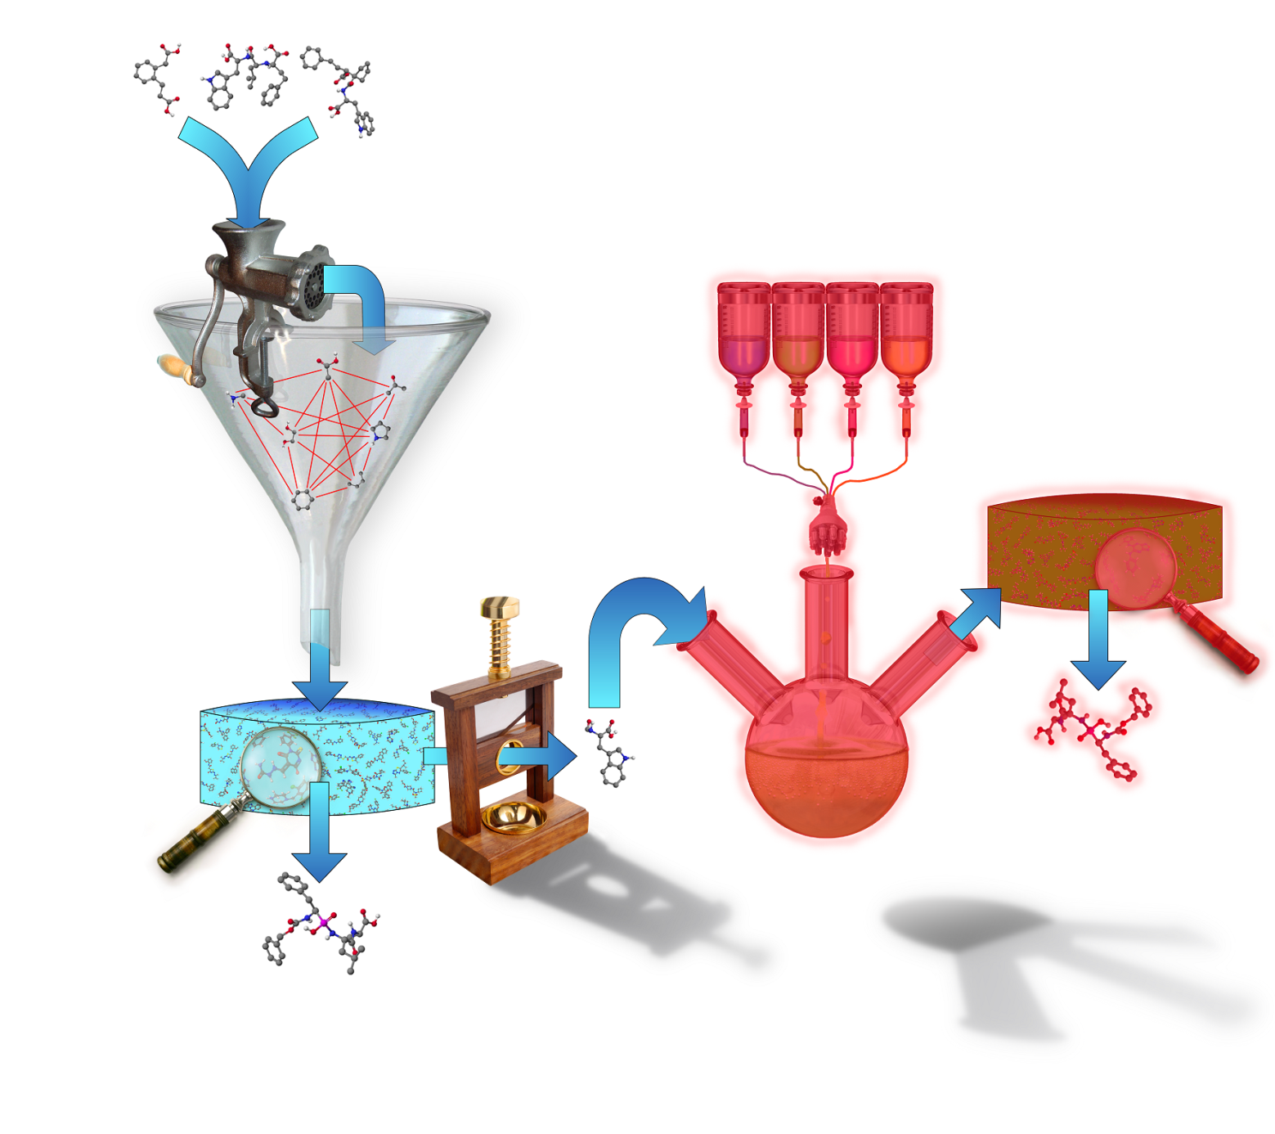

Slide 34
Carry out a virtual reaction
Simple Molecular Input Reaction Kinetic String (SMIRKS).
ChemAxon’s Reactor tool contains a library of SMIRKS along with rules about what a molecule must be like to participate in the reaction (Pirok et al, J Chem Inf Model, 2006).
INDDEx™ scans a SMIRKS describing a reaction, and builds a list of bond and atom changes.
[C:1]([H:2])(=[C:9])[C,N,P,S:5] + [C:3]=[N,O:4] >> [C:1]([C:3][N,O:4][H:2])(=[C:9])[C,N,P,S:5]
OH
O
+
EWG
EWG
R
R
H

Slide 35
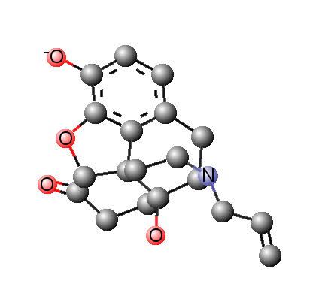
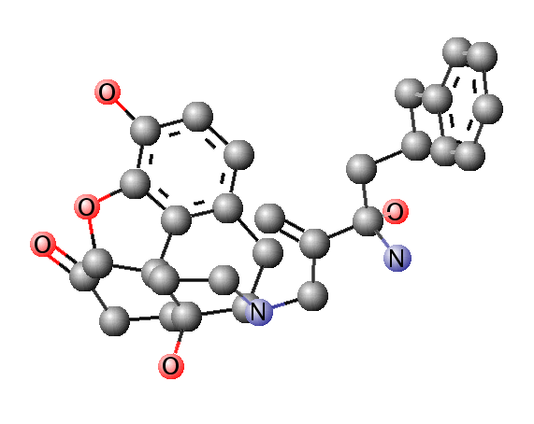
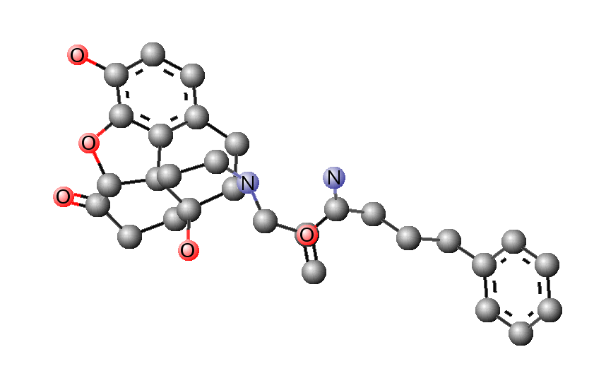
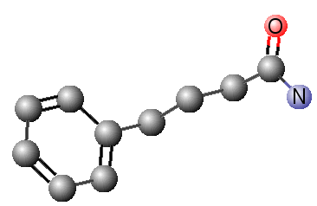
Predicted molecule
Minimised product
Reactants
Product
+
Predicted activity: 8.937
Predicted activity: 3.402

Slide 36
Results
Tested on publically available datasets
PubChem
Database of Useful Decoys
Compared with comparable virtual screening
Iterative Stochastic Elimination (ISE)
Collaboration with Paolo Di Fruscia on finding molecules to inhibit the SIRT2 protein.

Slide 37
Cross-validation
Measure predictive accuracy with
Pearson’s R² &
Spearman’s ρ
Perform 5 tests
Split into 5 sets by systematic sampling
Data
Train
Train
Train
Train
Test 5
Train
Train
Train
Test 4
Train
Train
Train
Test 3
Train
Train
Train
Test 2
Train
Train
Train
Test 1
Train
Train
Train
Train

Slide 38
Iterative Stochastic Elimination (ISE)
Machine-learning algorithm.
Uses repeated random sampling to build a map of search space.
Uses a series of physiochemical properties to describe each molecule.
Rayan et al, J Chem Inf Model, 2010.

Slide 39
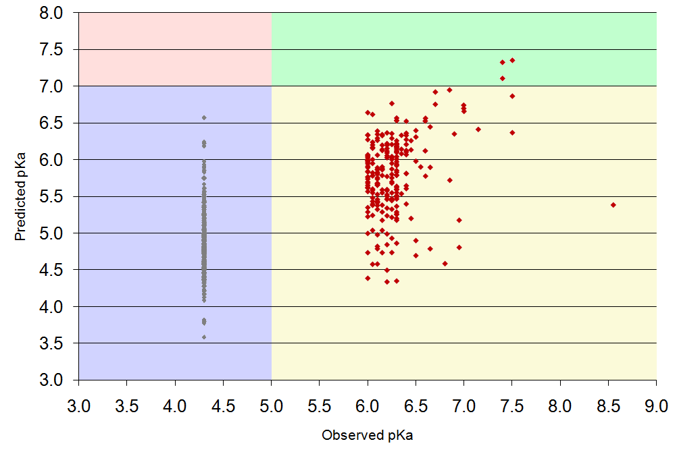
Observed vs Predicted activity
R² = 0.471
Spearman’s ρ = 0.662
False positives
True positives
Using a cutoff of 7.0 for positives,
Precision = 1.0
Recall = 0.014
Predicted pK_{i}
True negatives
False negatives
Observed pK_{i}

Slide 40
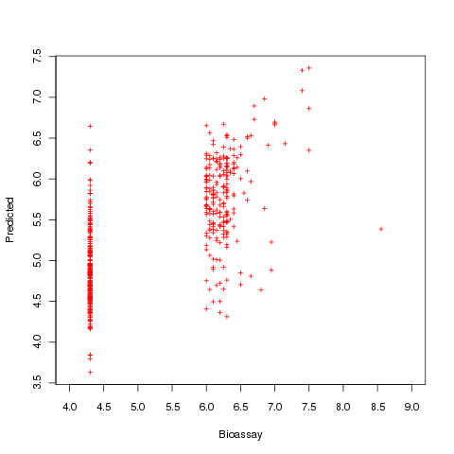
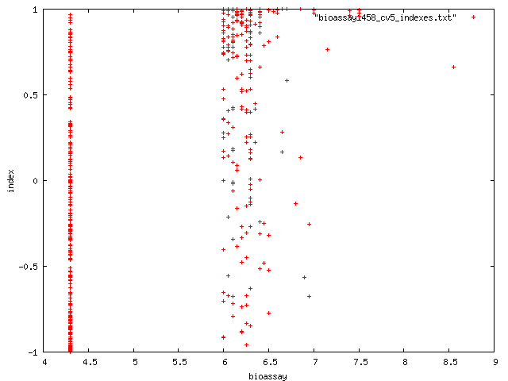
INDDEx™ vs. ISE
Spearman’s ρ = 0.662
Spearman’s ρ = 0.516
Predicted pK_{i}
Predicted pK_{i}
Observed pK_{i}
Observed pK_{i}

Slide 41
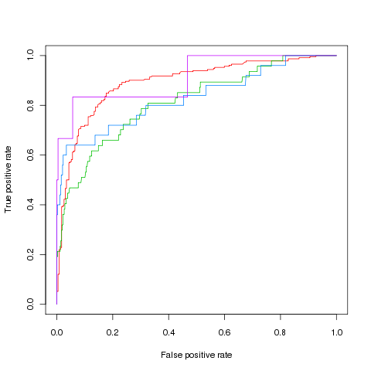
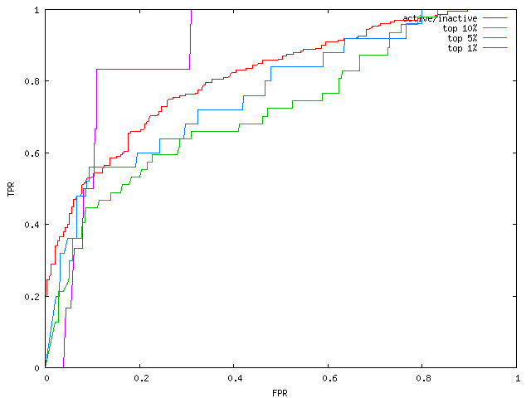
INDDEx™ vs. ISE
Enrichment portion | Number of actives | Area under the ROC
 |  | INDDEx™ | ISE
Top 1% | 6 | 0.912 | 0.883
Top 5% | 25 | 0.830 | 0.768
Top 10% | 47 | 0.814 | 0.718
Top 50% | 232 | 0.892 | 0.812
Top 1%
Top 5%
Top 10%
Active/Inactive
True positive rate
True positive rate
False positive rate
False positive rate

Slide 42
SIRT2 inhibition
SIRT2 is NAD-dependent deacetylase sirtuin-2.
3 chains, each one a domain.
Inhibition can cause apoptosis in cancer cell lines (Li, Genes Cells, 2011).

Slide 43
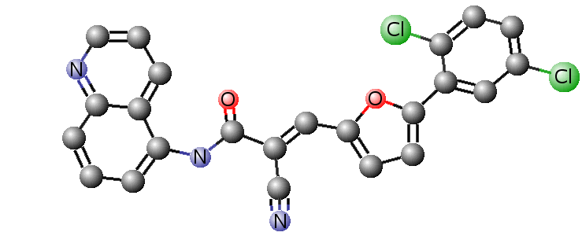
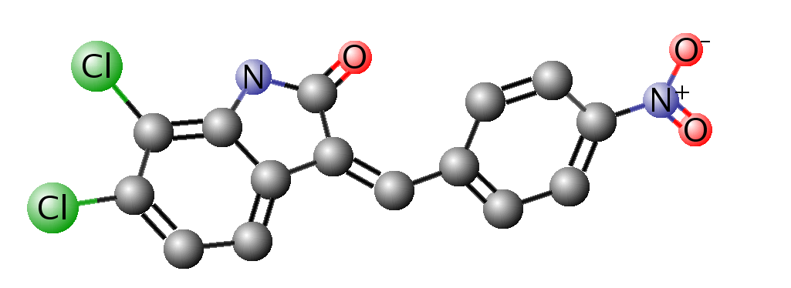
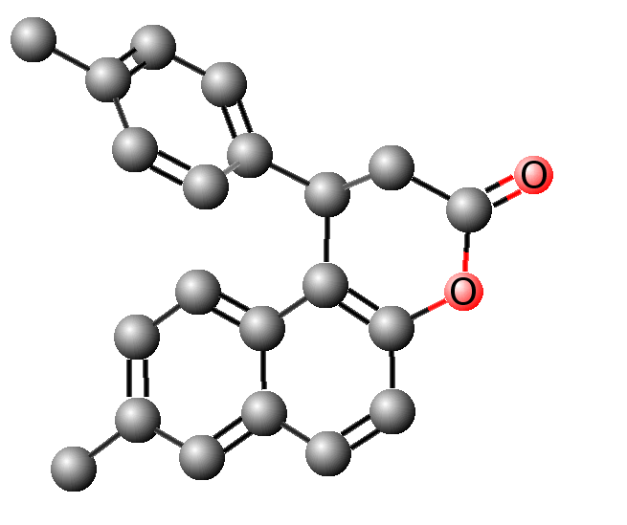
Molecules found by in vitro tests to have some low activity against SIRT2

Slide 44
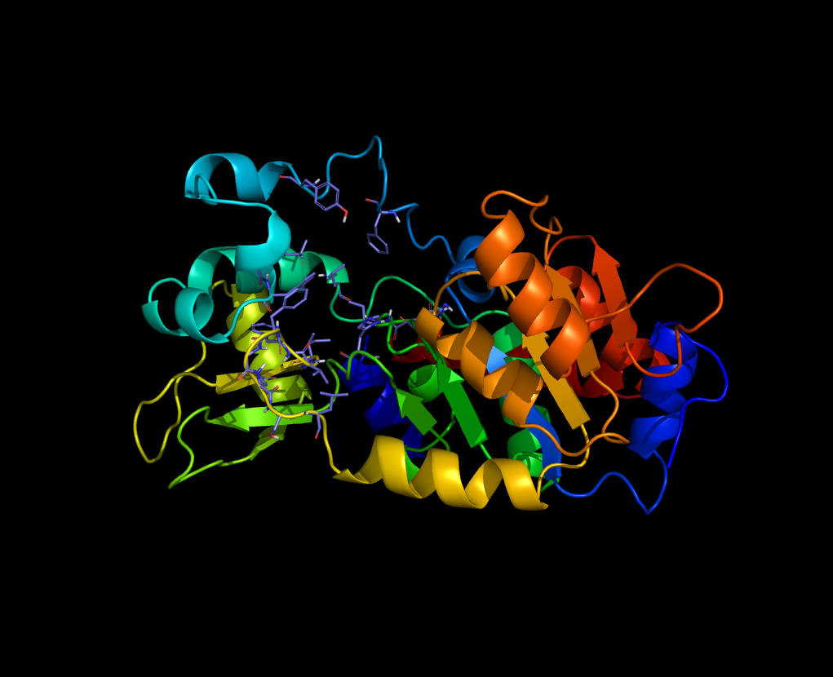
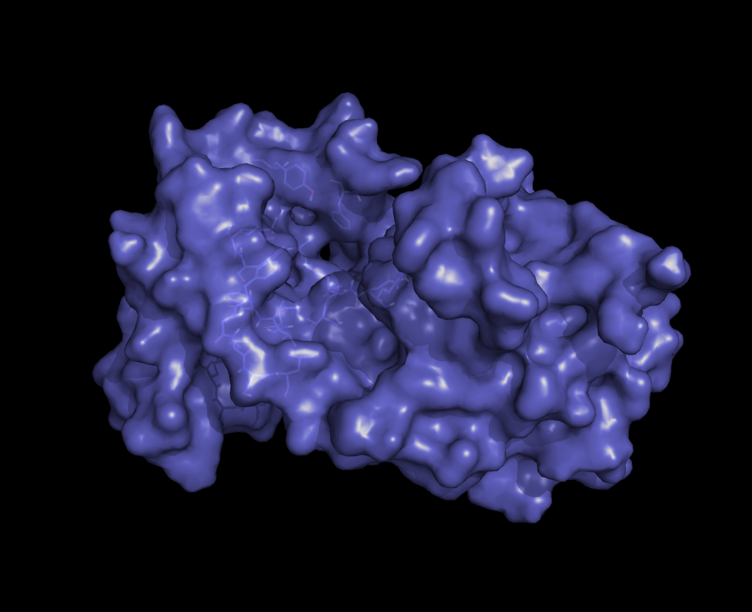
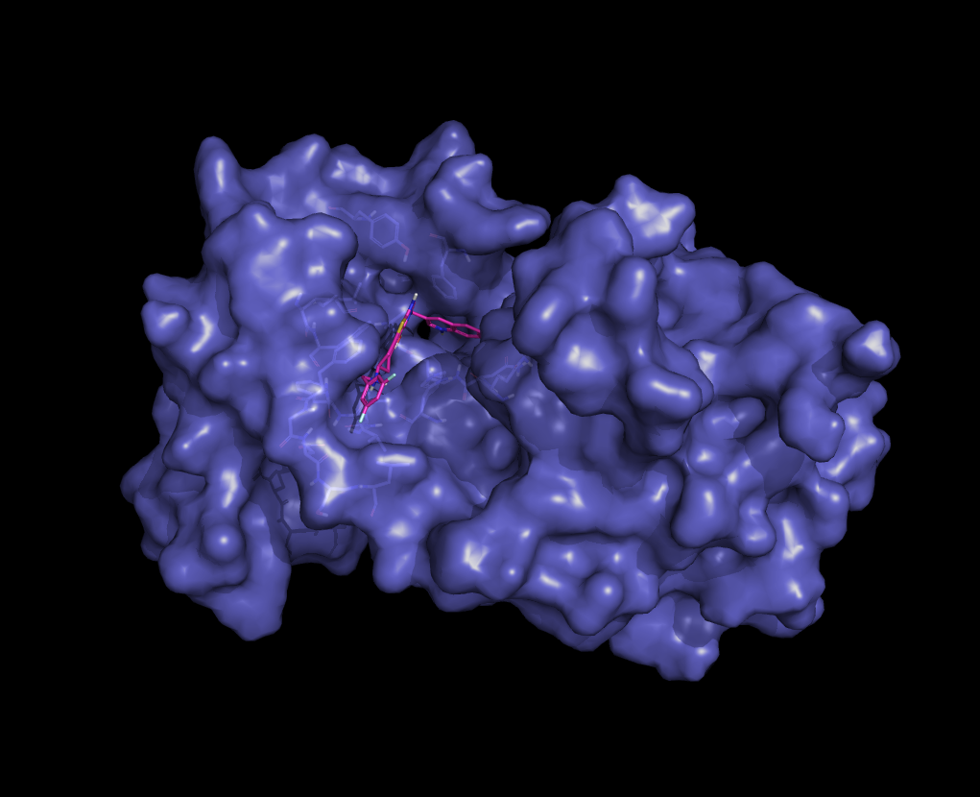
Predicted molecules docked against modelled SIRT2 protein structure using GOLD™
Predicted molecules with best docking scores purchased and sent for testing

Slide 45
Summary
INDDEx™ validated against other methods. Comparable results.
Future testing will compare with a whole group of virtual screening methods on Directory of Useful Decoys dataset.
Potential new drug leads found for SIRT2 protein – waiting for results of in vitro testing.
Virtual synthesis working. Testing of virtual synthesis still to be done.

Slide 46




Acknowledgments
Mike Sternberg Stephen Muggleton Ata Amini
SIRT2 drug design Paolo Di Fruscia Matt Fuchter Eric Lam
ISE comparison Amiram Goldblum David Marcus
Reaction Database ChemAxon
Progress Review Panel Paul Freemont Simon Colton
Imagery Wikimedia Commons iStockPhoto®
Funding BBSRC Equinox Pharma

Slide 47

Questions?

Slide 48
Chemical space
First two Principal component vectors of shape descriptors make a 2D plane.
Show positions of all approved drugs
Show positions of all the molecules in the ZINC database.

Slide 49
Searching for drugs
Databases of drug-like molecules are available, and virtual screening methods are available to scan them for potential drug leads, but the chemical space of available molecules is just a small part of the chemical space of all synthetically accessible molecules.
Zinc holds 1.13e-53 fraction
20 drops in a ml. 10^23 H atoms weigh 1 gram. 5x10^21 == H atoms to a ml. ~10^60 drops worth in the chemical universe. 9.4 x 10^79 H atoms in the universe. Therefore, 2e+58 drops in universe.
Not a drop in the ocean… Drop in the universe.

Slide 50
Aim of this project
Method of searching for synthetically accessible molecules.
This project will take an existing logic based machine-learning approach.
Further validate this methodology
Incorporate rules of chemical synthesis to design new, original, and more effective pharmaceutical drugs.

Slide 51
Lipinski’s Rule of Five
Lipinski’s (1997) rule is used to determine how likely a molecule is to be an orally active drug.
In general, an orally active drug has no more than one violation of the following criteria:
H-bond donors ≤ 5
H-bond acceptors ≤ 10
A molecular weight ≤ 500 daltons
LogP ≤ 5
The rule uses molecular properties which correspond to ADME pharmacokinetics in the human body.

Slide 52


Understandable rules
?
Standard programs:
Activity = 0.45 LogP + 0.56667 LUMO + 1.65 V
ILP rule:
In an active molecule:
Fragment A is 7Å from fragment B which is bonded
to fragment C which is bonded to fragment D
7Å
B
C
D
A

Slide 53
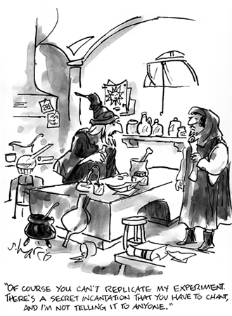
Repeatability
How do we compare this method with another method?

Slide 54
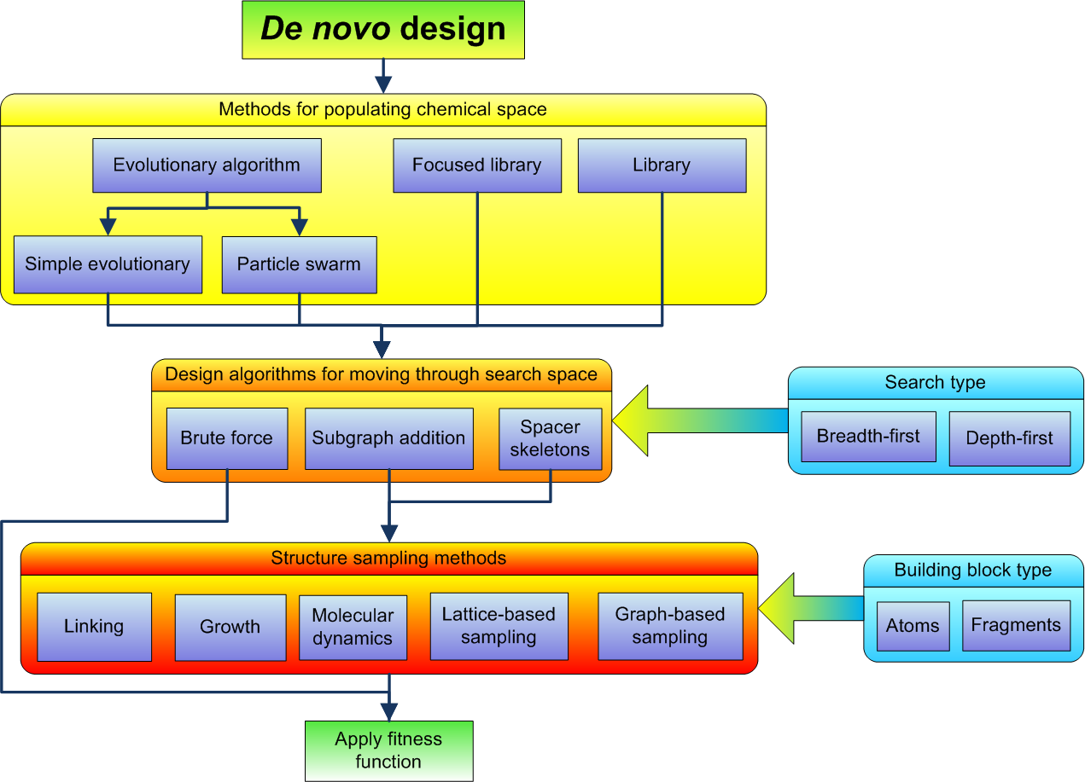
De novo design hierarchy

Slide 55
Building a virtual library
Fragment-based virtual synthesis applies this scheme to virtual synthesis. chemical space can be covered more efficiently by considering fragment-like molecules.
GDB-13 (Fink and Reymond, 2007) contains all stable, synthetically feasible, molecules with up to 13 atoms of C, N, O, S and Cl.
10⁹ structures
Largest publicly available small organic molecule database.
Pfizer Global Virtual Library
10¹³ structures
Too large to search by brute-force methods
InhibOx’s VSPACE , which is a virtual library of molecules created using ChemAxon’s virtual reaction toolkits.
4x10⁹ structures

